Slide 1

NativeScript and Angular 2, Sitting in a Tree
Jen Looper (Telerik DevRel) @jenlooper

Slide 2
Ph.D. … in Medieval French (13th century prose romance FTW)
Retrained!
Worked in startup, nonprofit, big corporate 14 yrs+
A lot of side projects ladeezfirstmedia.com
Now DevRel@Telerik
Notes:
Who am I?

Slide 3
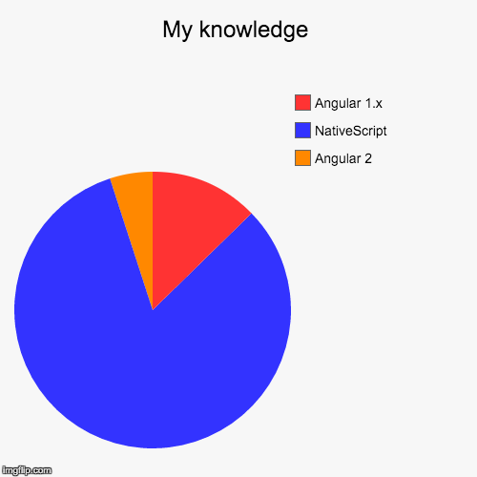
I’m a developer & I like mobile apps!
Notes:
Who am I?

Slide 4
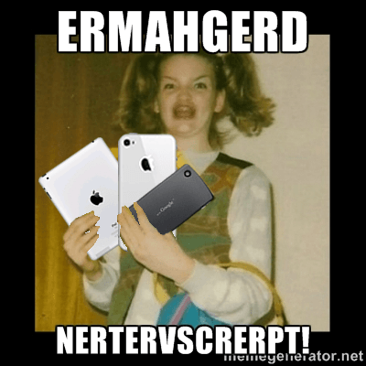
I like NativeScript
Notes:
Who am I?

Slide 5

Notes:
For the past several months we’ve been working directly with the Angular team to bring Angular 2 and NativeScript together…
We are doing this to provide the same experience of building mobile apps as it is for web apps.
And thus allowing Angular 2 developers to reuse their skills.
It’s all about skills reuse and code reuse.

Slide 6



Tobias Bosch
Hristo Deshev
Notes:
So, regularly since last May 9, :
A lead developer from the Angular Team [picture of Tobias Bosch]
and Telerik Team [picture of Hristo Deshev]
met using Google Hangouts to plan… (next slide)

Slide 7

Notes:
Mobile App World Domination

Slide 8


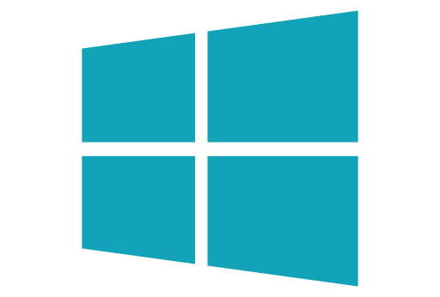
What is NativeScript?
A runtime for building and running native iOS, Android, and (soon) Windows Phone apps with a single, JavaScript code base

Slide 9
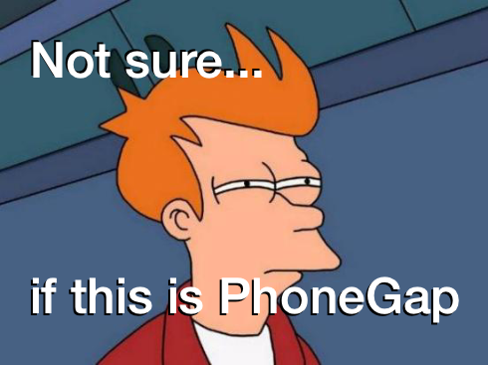

Slide 10


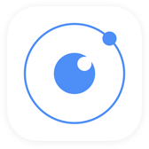



!=
No DOM
!=
No cross compilation
!=
Direct access to native APIs in JS
Notes:
{N} in a N app, there is no DOM! We don’t rely on the browser to serve up a mobile-ish web page. Our elements are native mobile elements.
{N} vs Xamarin - no cross compilation at all
{N} vs React Native and Appcelerator (Titanium) – we offer direct access to native APIs in JS

Slide 11
Why NativeScript?
Skills reuse
JavaScript and CSS
Angular2
Code reuse
npm modules, 3rd-party iOS and Android libraries
Easily use native APIs
No wrappers to access native APIs
Use native UI elements
Open source!

Slide 12





Bridge

Slide 13
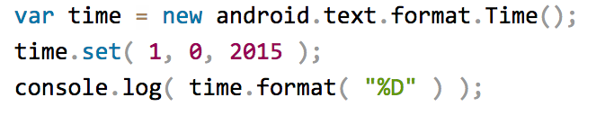
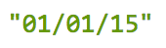
NativeScript Android example
Output:
Notes:
What’s going on here? this JavaScript code instantiates a Java android.text.format.Time() object, calls its set() method, then logs the return value of its format() method, which is the string "01/01/15".

Slide 14
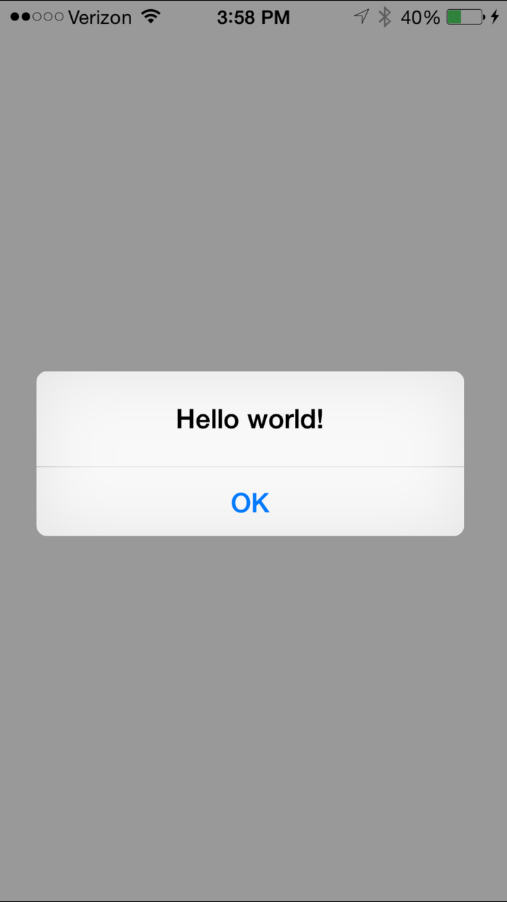
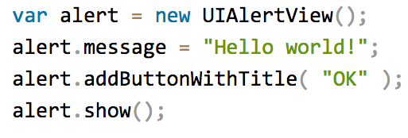
NativeScript iOS example
Notes:
This JavaScript code instantiates an Objective-C UIAlertView class, sets its message property, and then calls its addButtonWithTitle() and show() methods. When you run a NativeScript iOS app with this code you'll see the alert below:

Slide 15
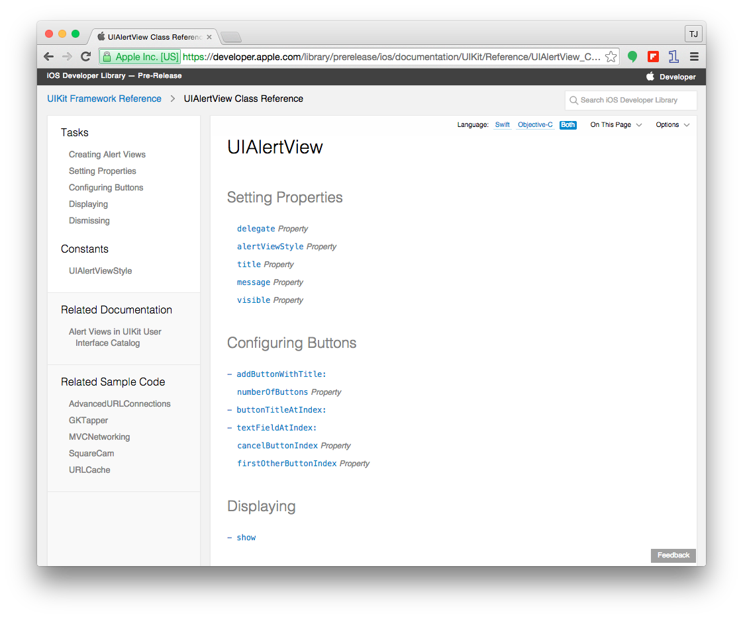

Slide 16

How does this even?

Slide 17
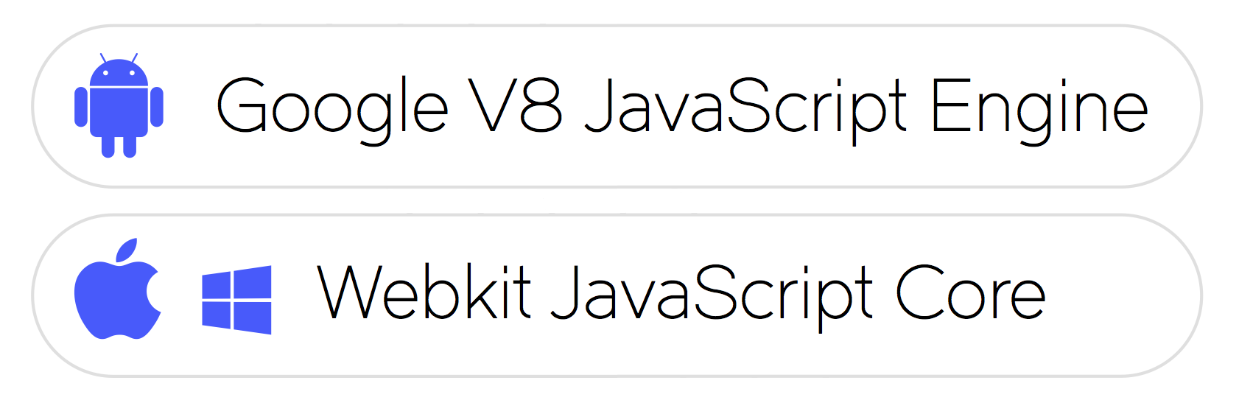
JavaScript Virtual Machine
Notes:
NativeScript is not just a set of libraries, but rather a Runtime that enables you to call native APIs: for Android, iOS and Windows Universal. Think of it as a translating engine.
It uses a pre-packaged JavaScript Virtual Machine to bridge between JavaScript code and Native APIs. To be precise:
•For Android it is – Google’s v8 JavaScript Engine,
•For iOS and Windows Phone it is – WebKit’s JavaScriptCore

Slide 18
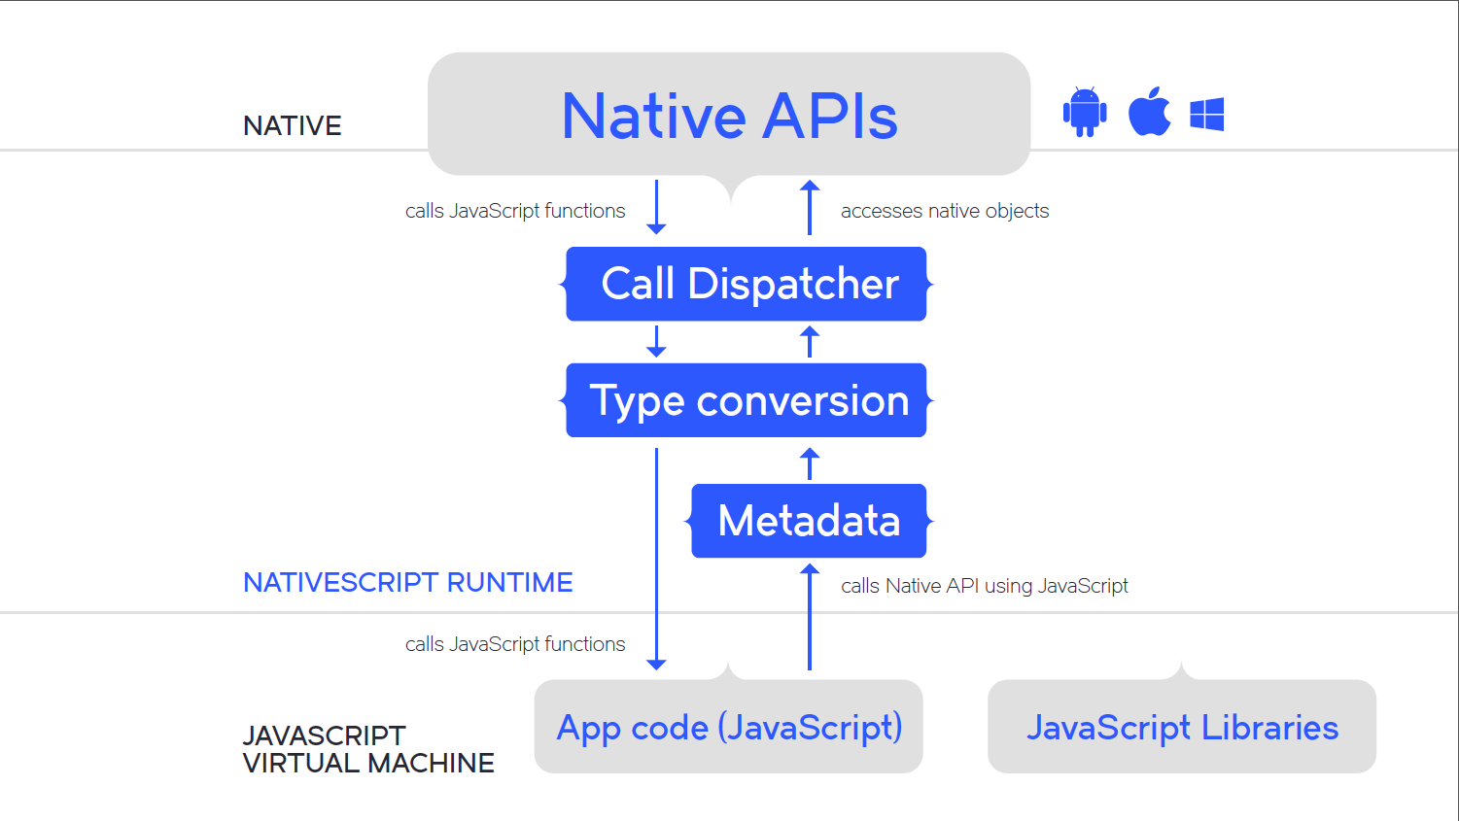

Slide 19

But…who wants to write native iOS or Android code?

Slide 20
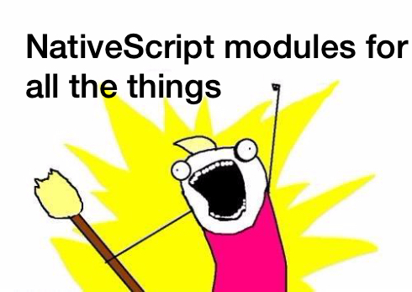

Slide 21



NativeScript modules
Code
Modules
Platform API
2016
Notes:
NativeScript comes equipped with modules that provide cross-platform functionality.
There are dozens of them and they’re easy to write yourself.
NativeScript modules follow Node module’s conventions (CommonJS).

Slide 22
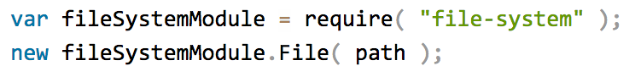
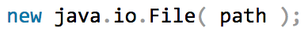
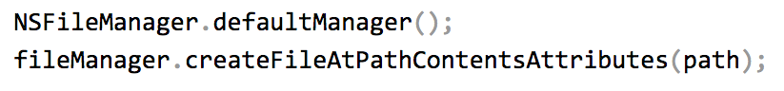
NativeScript file module
Notes:
import the 'file-system' module with a 'require' statement, then with one line, get the module to create a file at a certain path that you provide.
the module leverages the native ways of dealing with the File api on Android
...and iOS,
so that you don't have to.

Slide 23
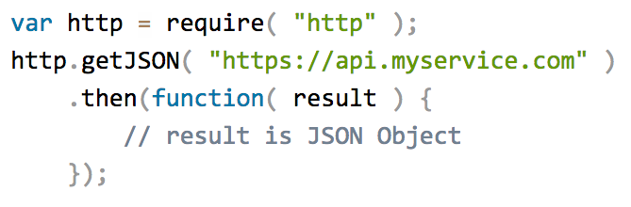
HTTP module example
Notes:
here's an example of a cross-platform module, the 'http' module, that simplifies making http requests to an API such as forecast.io, so that you could request json to be returned from a service.

Slide 24
Why NativeScript + Angular 2?
Angular 1 = a technology that relies on browser tech to manipulate the DOM.
NativeScript has no DOM to manipulate
Angular 2 decoupled the Angular framework from the DOM
The door is open to new mobile-friendly tech to leverage this newly decoupled framework!!
Notes:
N apps can’t use browser tech like span etc. to build an interface, you must build using N ui components

Slide 25
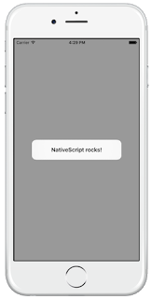
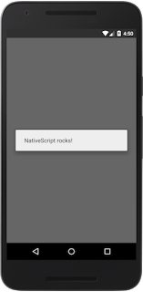
A standard {N} app snippet
<!-- main.xml --> <page>
<StackLayout>
<Button text= "Hello World" tap= "showAlert" />
</StackLayout>
</page> /* main.js */ var dialogs = require("ui/dialogs"); exports.showAlert = function() { dialogs.alert({ message: "NativeScript rocks!" }); };
Notes:
This code will open a native dialog when a native button is tapped

Slide 26
Same functionality, {N} + ng2
// main.ts import {nativeScriptBootstrap} from "nativescript-angular/application"; import {Component, View} from "angular2/angular2"; import {dialogs} from "ui/dialogs"; @Component({}) @View({ directives: [], template: ` <stack-layout> <button (tap)="showAlert()" text="Hello World"></button> </stack-layout> ` }) class HelloPage { showAlert() { dialogs.alert({ message: "NativeScript rocks!" }); } } export function loaded() { nativeScriptBootstrap(HelloPage, []); }
Notes:
NativeScriptBootstrap() vs. bootstrap()
In an Angular 2 web app, you call the bootstrap() function in the "angular2/angular2" module to initialize your components.
In NativeScript apps you need to call nativeScriptBootstrap(), which is a lightweight wrapper of bootstrap() that does some NativeScript-specific initialization.
The UI components in the template
In an Angular 2 web app your “Hello World” button example would probably be rendered as <div><button>Hello World</button></div>.
But in NativeScript apps you need to use XML widgets that NativeScript is able to render in native mobile apps.
This example uses a <stack-layout> element, which is the simplest of NativeScript’s layouts, and places a single <button> element within it.

Slide 27
The big picture
Abstraction
Layer
XMLHttpRequest
<NS Module>
Implementation
Native
iOS call
Native Android call
Destination
iOS App
Android App
Notes:
A NativeScript App

Slide 28
The bigger picture ({N}+NG2)
Abstraction
Layer
HTTP
<Angular Component>
XMLHttpRequest
<NS Module>
XMLHttpRequest
<Browser>
Implementation
Native
iOS call
Native Android call
Ajax call
Destination
iOS App
Android App
Web App
Notes:
A NativeScript app with Angular love - that's going to have code reuse to the web

Slide 29
One syntax for all
Attribute Binding: | [attribute]
Event Binding: | (event)
Intercepting input: | #idhandler
Conditions: | *ng-if="expression"
Loops: | *ng-for="expression"
Styling: | [class.style1]="expression"

Slide 30
The difference is in the UI
Web UI != Mobile UI
Notes:
This might be obvious

Slide 31
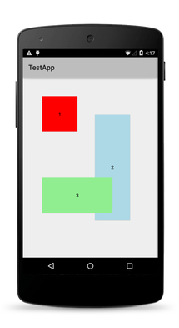
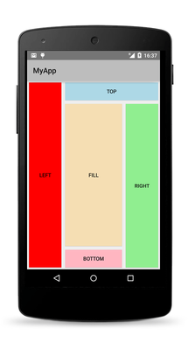
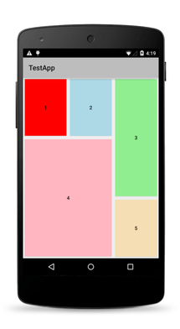
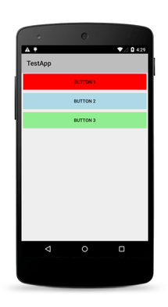
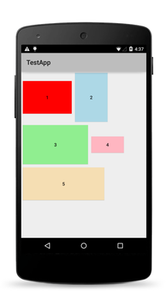
Native Layouts
Absolute
Dock
Grid
Stack
Wrap

Slide 32
Let’s take it for a spin!
Use a template to create a sample app:
$ tns create myNewAngularApp --template https://github.com/NativeScript/template-hello-world-ng
$ tns emulate ios

Slide 33
Clone a repo:
TodoMVC – git clone
https://github.com/NativeScript/sample-ng-todomvc
$ npm install
$ tns platform add ios
$ tns platform add ios
$ tns emulate ios
PocketRave
https://github.com/jlooper/pocketrave-app
Notes:
If you would like to try it for yourself just go to any all of the github repos, clone them and follow the instructions.

Slide 34

Learn more & enjoy!
NativeScript.org
NativeScript Slack Community
http://bit.ly/nativescript-slack
Really useful article: http://bit.ly/n-ng2
@nativescript
@jenlooper
Notes:
Learn more!

